Slide 1
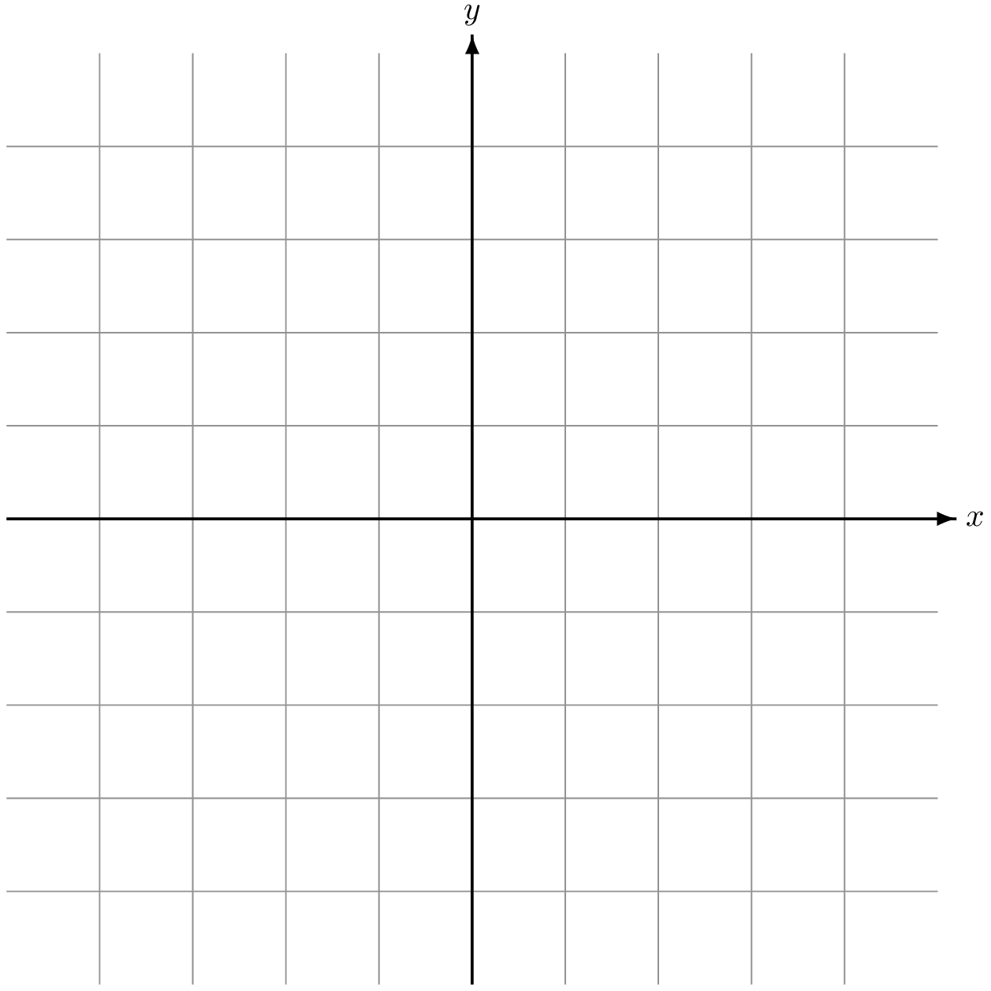
v2
θ
p3
v1
p2
p1
Create two vectors
Normalised and dot product

Slide 2
Racing line data file
Track sections data file
1,{0,0} 2,{0.23,0} ….. ….. X,{x,y}
Track Splicer
Straight,1528,90
Corner,91,242,165 ….
….
Corner,560,600,580
Input
Output

Slide 3
pM
p1
pX

Slide 4
Telemetry data
Coordinator
New Feedback
Main Thread
Telemetry data
Shared Memory
New Telemetry Data
Feedback Module 1
Feedback Module 2
Feedback Module x
Thread 1
Thread 2
Thread x
Thread 1,1
Thread 2,1
Thread x,1
Module 1 Tasks
Module 2 Tasks
Module x Tasks

Slide 5
Telemetry
Is braking?
yes
Is analysing?
no
Start analysis
no
yes
Discard telemetry
Is analysing?
Store telemetry
no
yes
Stop analysis
Is Feedback required?
yes
Braking too hard
yes
Front slip >= threshold
no
Braking too light
yes
Front slip >= threshold
Started braking
Analyse Stopped
Analysing Telemetry
Stopped braking

